Slide 1

Flocculator Extras

Slide 2



How do we quantify the turbulence level?
extra
The energy dissipation rate, ε, is a measure of the turbulence
It is in the regions of maximum ε where the flocs are most likely to break
mW/kg

Slide 3
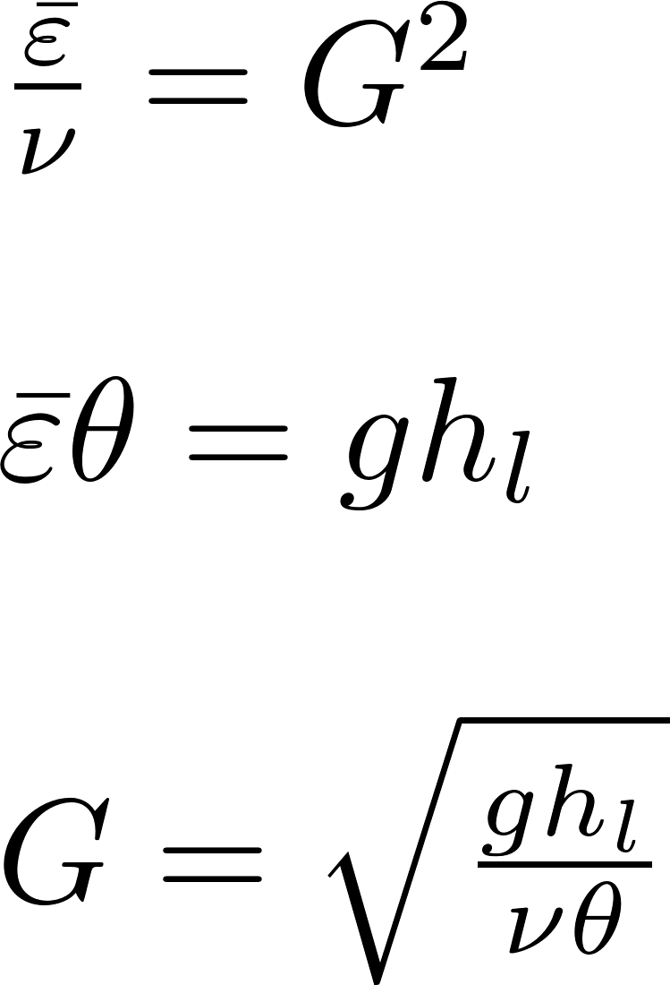
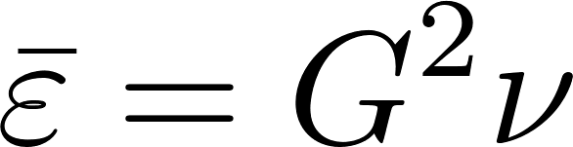
Extracting ε from Velocity Gradient Design Guideline?
extra
The value of the velocity gradient that was used previously for flocculator design had a range of 20 – 200 s⁻¹
The equivalent range for ε is 0.4 – 40 mW/kg
Kinematic viscosity
Velocity gradient
Notes:
This is the first of 3 methods to obtain estimates for the energy dissipation rate (traditional G values, traditional velocity values, floc size in a shear environment.

Slide 4
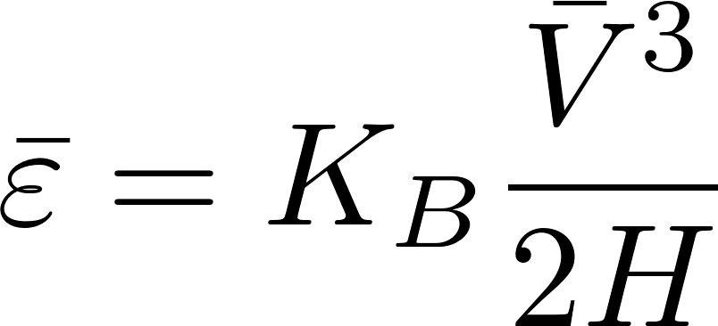
Extracting ε_{Max} from Fluid Velocity Design Guidelines?
extra
Traditional guidelines for velocity are between 0.1 and 0.3 m/s.
Equivalent to of 0.5 to 15 mW/kg

Slide 5
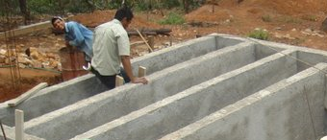
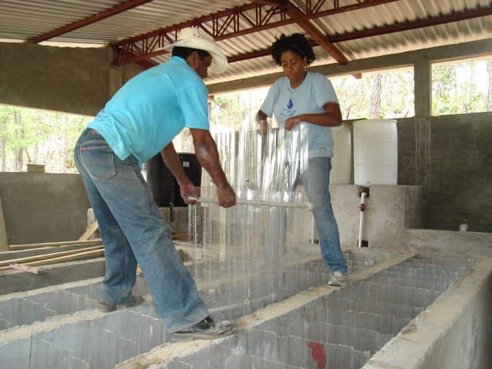
Design Considerations
Design is dominated by material size and constructability
Channels must be wide enough to be constructible (45 cm)
The material used for flexible plastic baffles is expensive and waste should be minimized

Slide 6
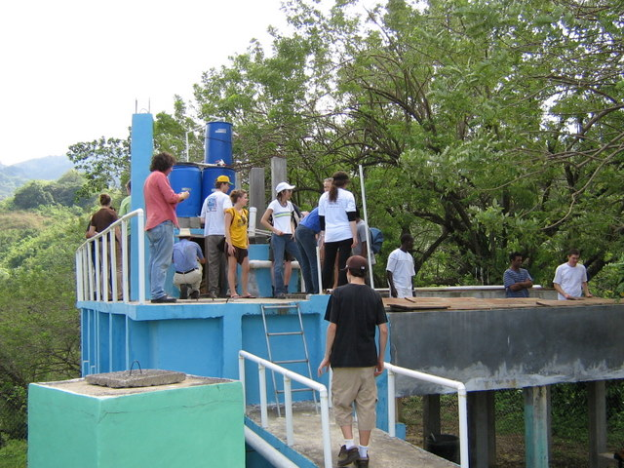
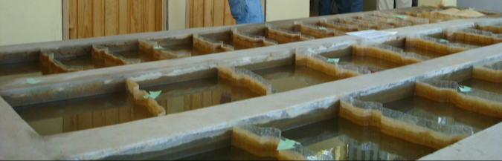
Vertical vs. Horizontal Flow
extra
For small plants…
Horizontal flow flocculators are shallow and thus need to be elevated so the water level in the flocculator matches the sedimentation tank
Vertical flow flocculators take up less space (smaller footprint) because they are deeper
For large plants…
Horizontal flow can be made as deep as the sedimentation tank and are preferred because they are easier to drain
Notes:
Note that these recommendations are the opposite of the recommendations from CEPIS! CEPIS used deep horizontal flow flocculators even for relatively low flow rates (less than 50 L/s). The result is many flocculators with extremely close baffle spacing and resulting inefficient use of flocculator volume because of high variability in energy dissipation rate.

Slide 7
Vertical vs. Horizontal Revisited
extra
Vertical flow flocculators are somewhat difficult to drain and clean
For large flows, vertical flow flocculators have channels that are wider than they are deep
Why not switch to horizontal flow flocculators for large flows?
Why not use horizontal flow for all flows?

Slide 8
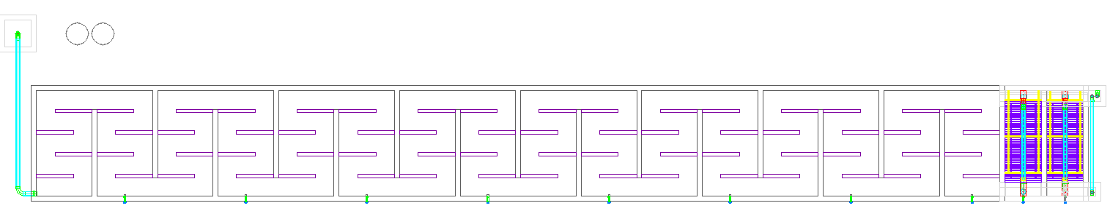
Horizontal flow for all flows?
extra
5 Lps plant with horizontal flocculator
This is a bad alternative because concrete slab floor, roof, walls, and land are all expensive!!!

Slide 9
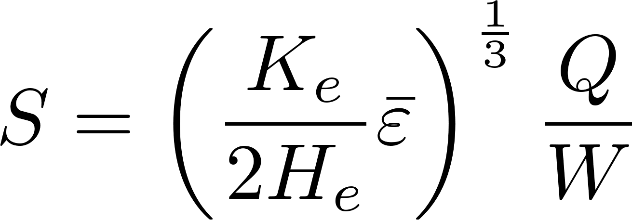
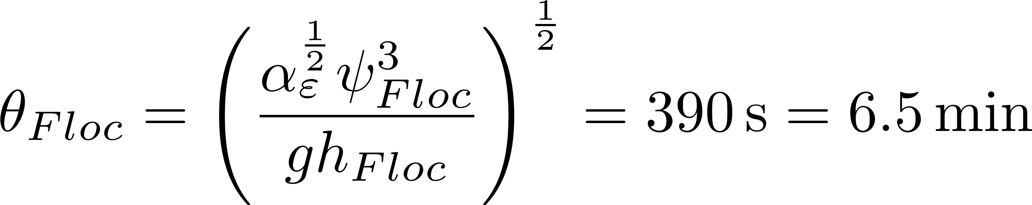
Horizontal Flow Flocculator
extra
Depth of the water is known (W)
Width of the channel is H (unknown)
Use H/S of 3 as a constraint
Solve for S and then finally solve for H
Eliminate H with H/S

Slide 10
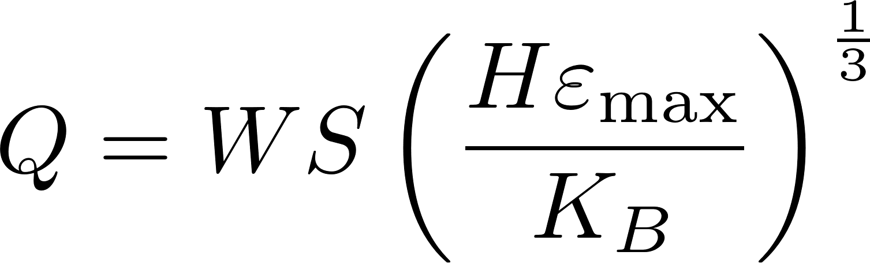
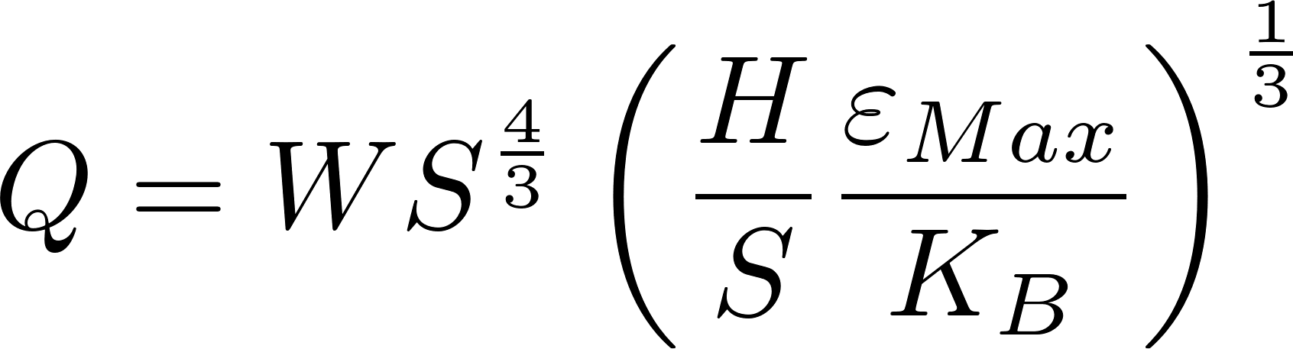
Minimum Flow rate for Horizontal Flocculators given H?
extra
The construction constraint requires that baffles be at least 45 cm (we will use 60 cm) apart (S).
The depth of water is W
Use an H/S of 3 and calculate H
Solve for Q

Slide 11
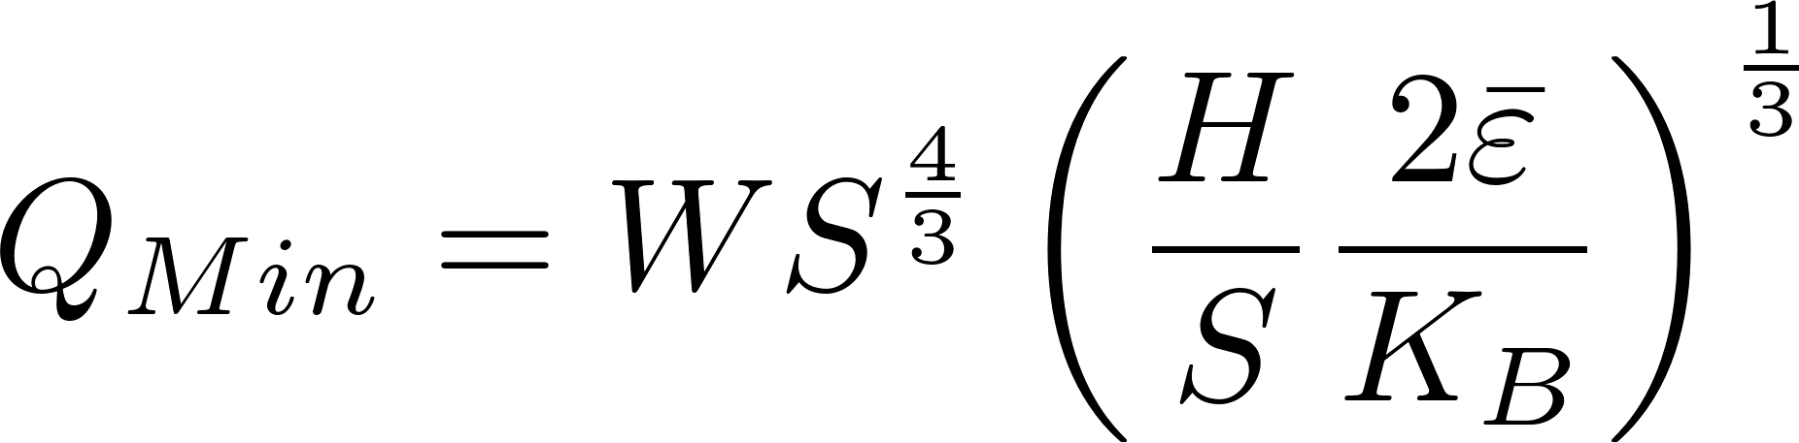
Minimum Flow rate for Horizontal Flocculators?
extra
The minimum flow rate for a 2 m deep tank is about 250 L/s
If we build shallower flocculators then we could design horizontal flocculators for lower flow rates (perhaps as low as 50 L/s), but this would increase plant size
Water surface elevations (sed and floc) must match!
So… don’t expect to see any AguaClara horizontal flocculators

Slide 12
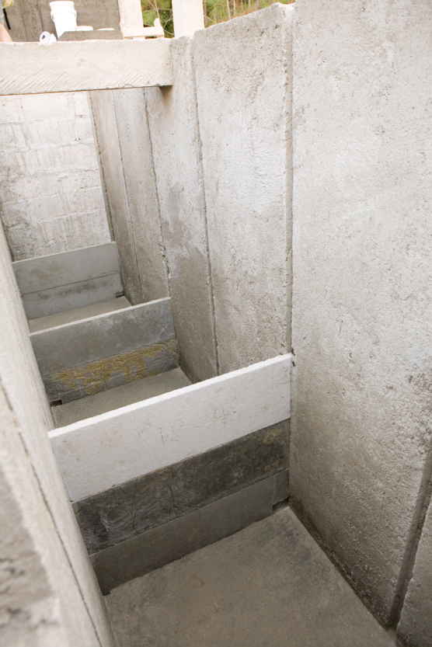
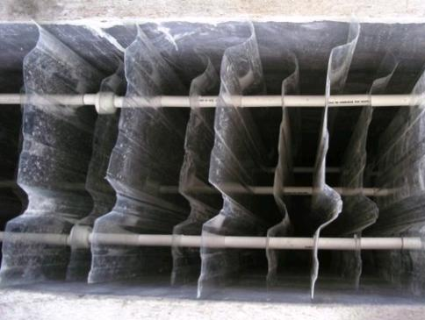
And More Details
extra
How will we fill or drain the flocculator?
What force must the baffles be able to withstand?
Polycarbonate baffles
Ferrocement baffles

Slide 13
Small Drain Ports at the bottom of the lower baffles?
extra
The ports would have a smaller size than the space between baffles
The energy dissipation rate in the jet that flows through the ports will be higher than the energy dissipation rate produced by the baffles
Preliminary evidence from the AguaClara plant at Marcala, Honduras suggests that this approach works well and can still produce low residual turbidity

Slide 14
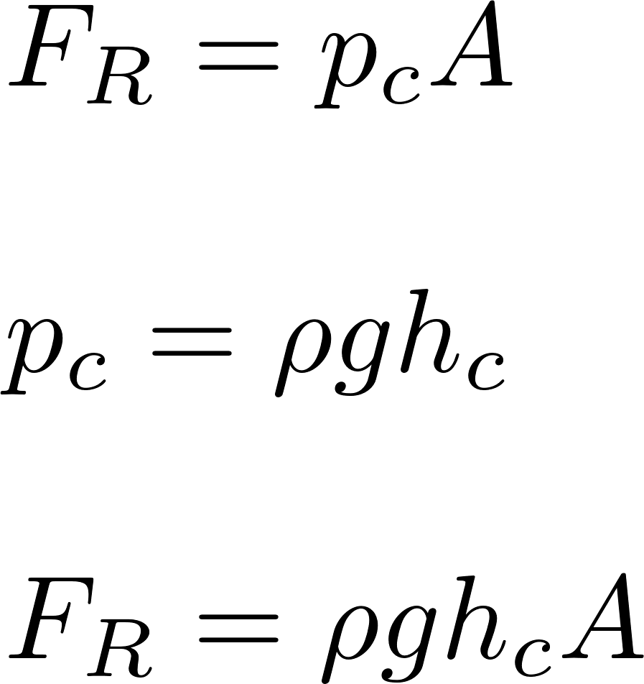
Hydrostatic Force: Vertical flow flocculator
extra
Upper baffles
S
H
B
S
S
L
Lower baffles
W currently use 1.5S above and below the baffles
Notes:
Change this image to have 1.5 S

Slide 15
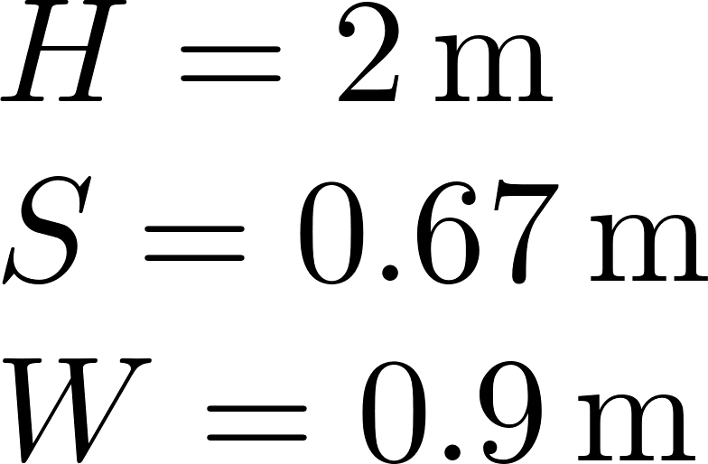
Hydrostatic Force
extra
Where will the baffle break?
If we make the baffle from 4 plates, what force will the lowest plate have to withstand?

Slide 16
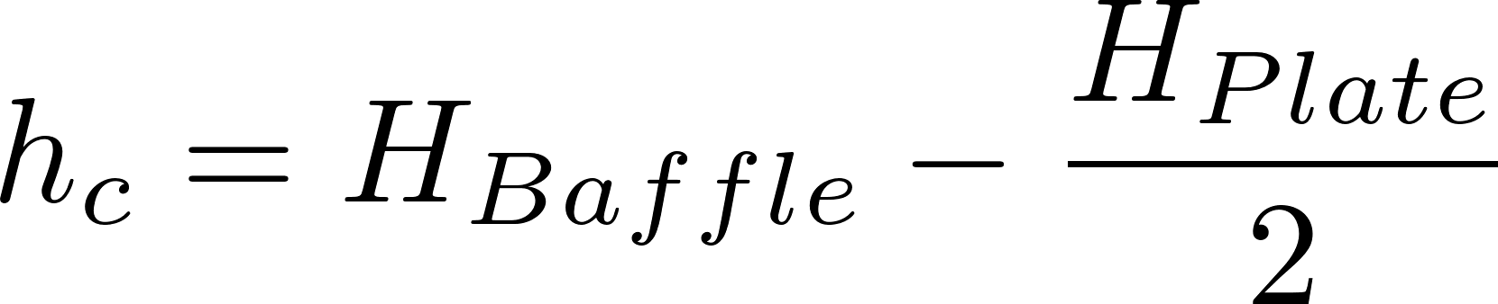
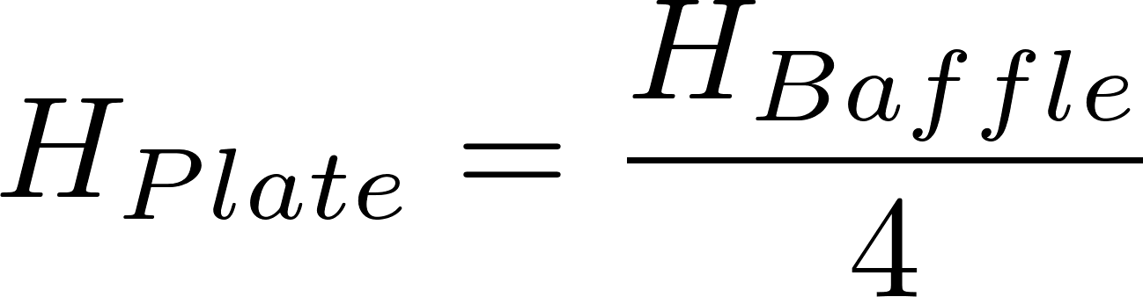
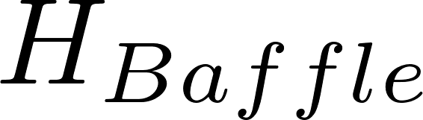
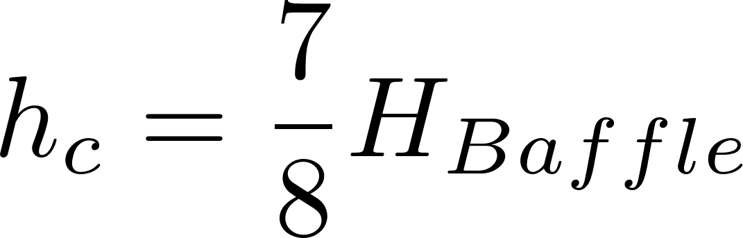
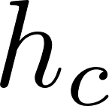

Hydrostatic Force
extra

Slide 17
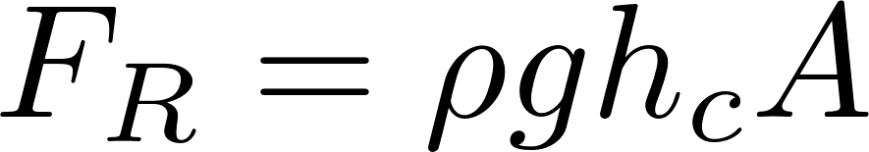
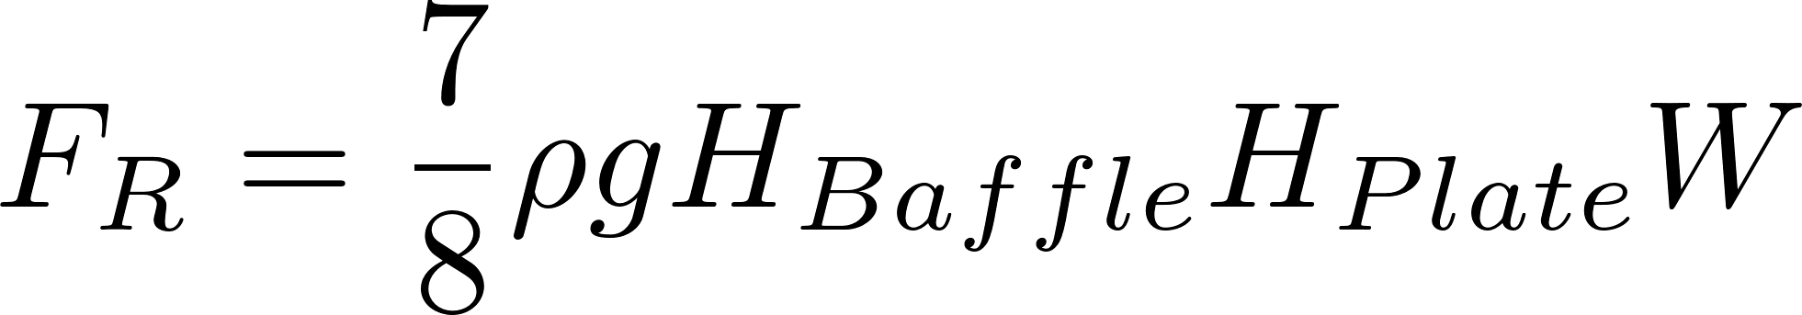
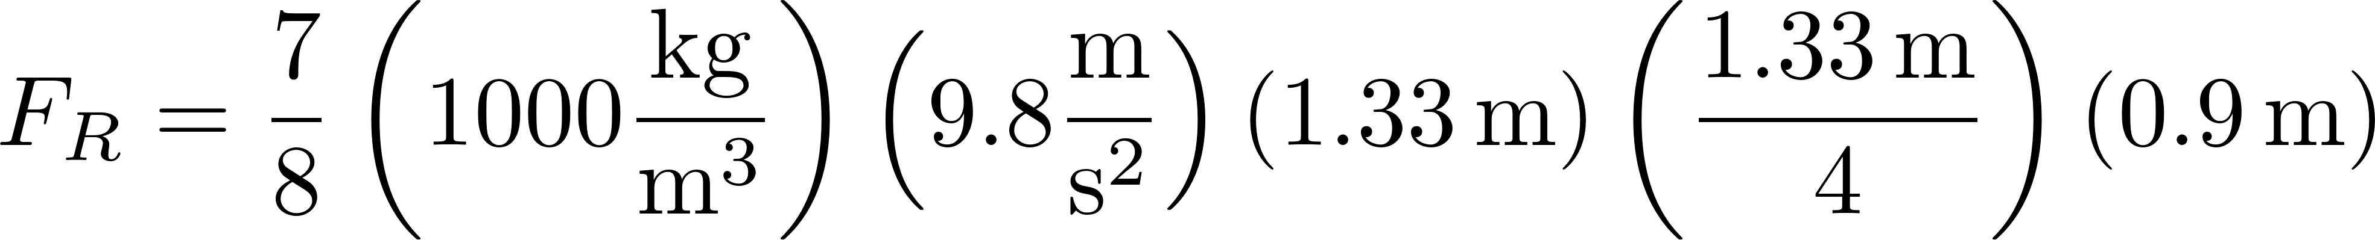
Hydrostatic Force
extra
3413
N

Slide 18
Pro Uniform Flocculation
extra
Most energy efficient (less head loss) or
Given same amount of energy, lower residence time!
Unlikely that the higher shear levels would result in significant changes in floc density or strength
Easier to build
Until we have solid evidence that tapered is better we will use a constant ε

Slide 19
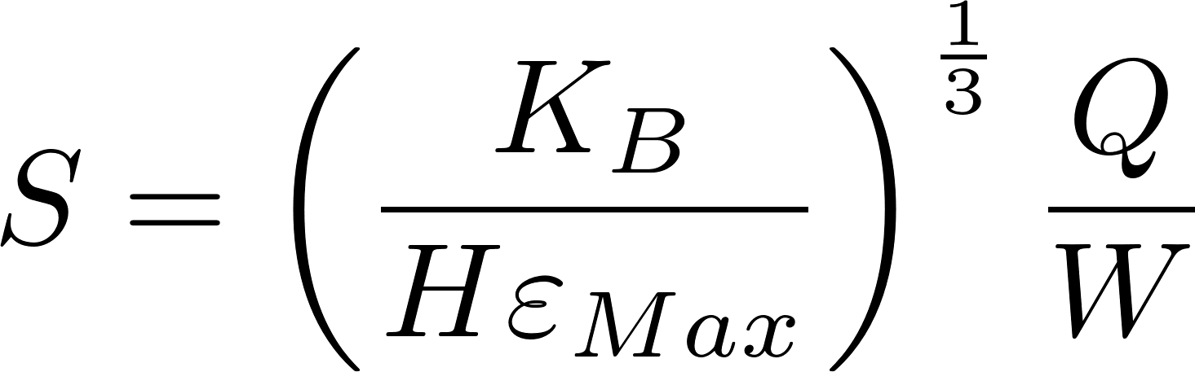
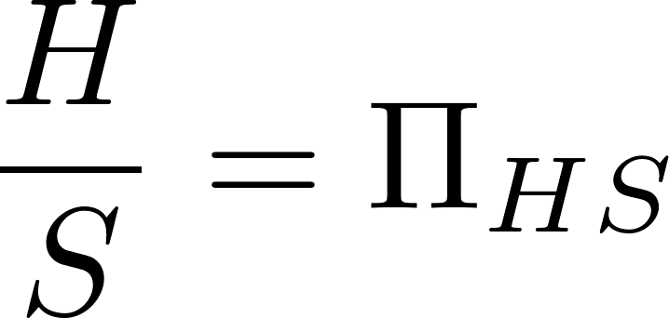

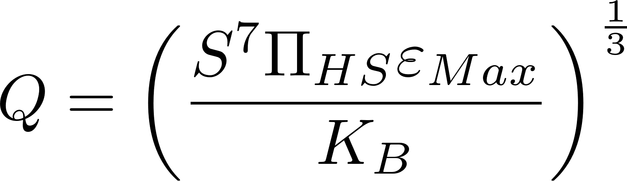
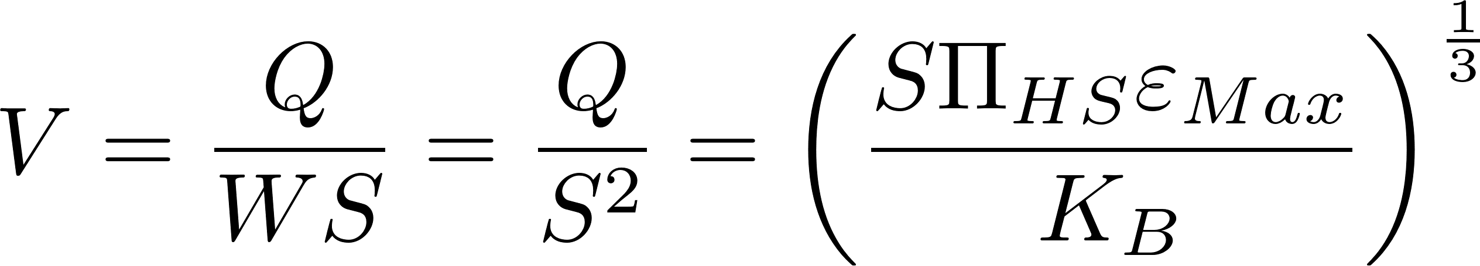
Smallest Turbulent Flow Flocculator (analysis for lab flocculator)
extra
Substitute W=S and eliminate H. Then solve for Q
This is a fundamental equation showing energy dissipation is proportional to velocity cubed

Slide 20
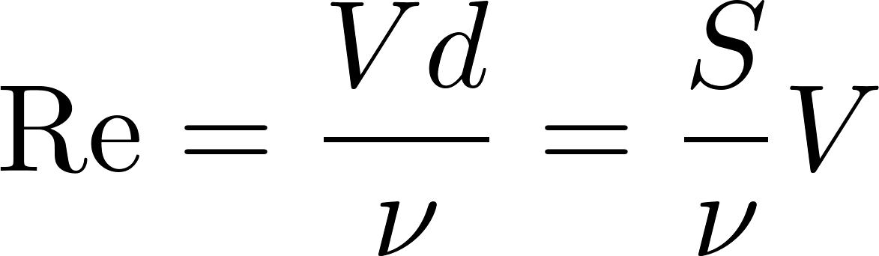
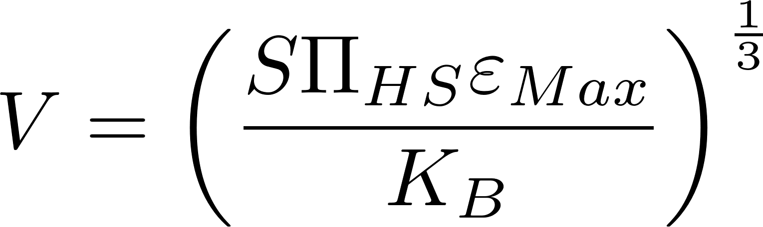
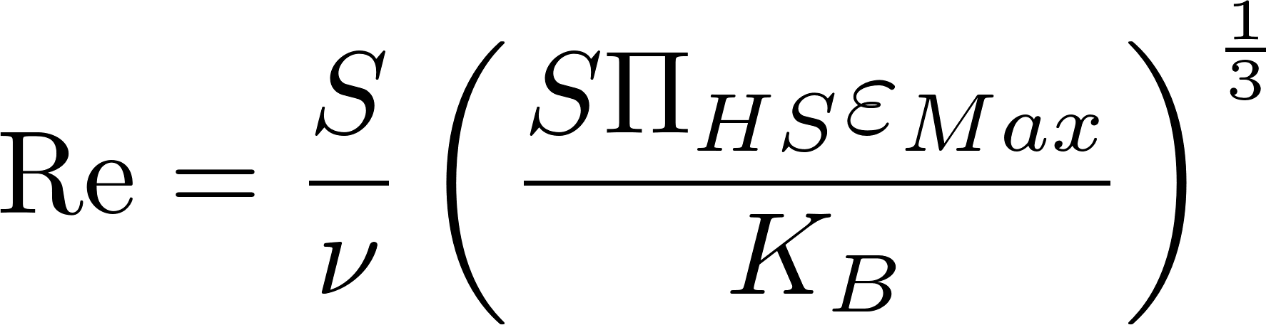
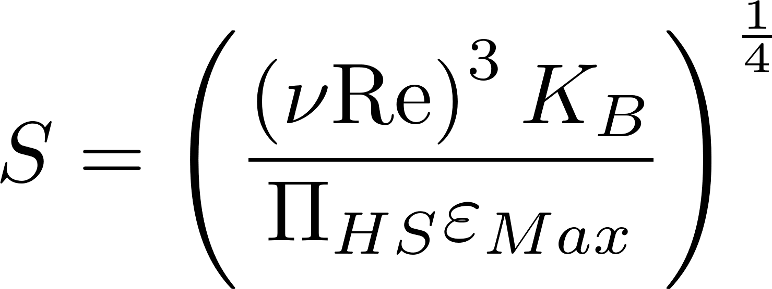
Add Reynolds constraint
extra
Solve for S to get minimum S given Reynolds constraint

Slide 21
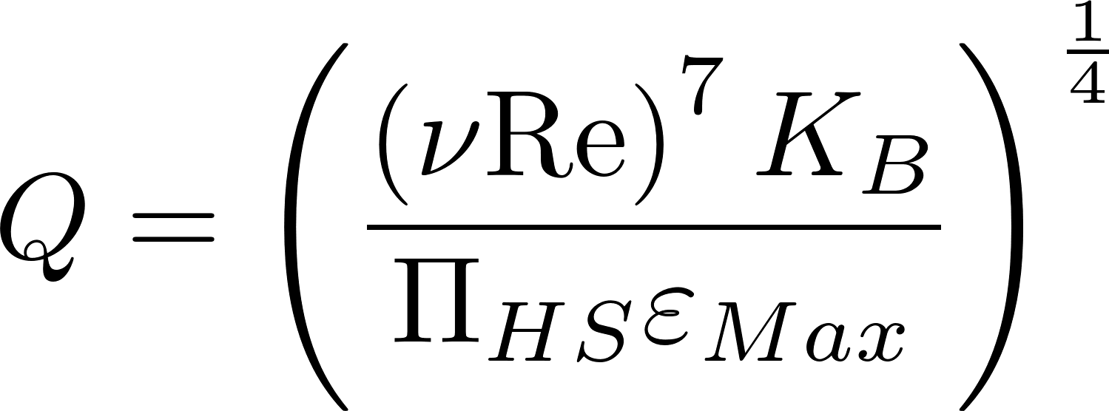
Minimum Turbulent Flow Flocculation
extra
Combine equation for Q and S to get Q as function of Re.
The minimum flow for a turbulent flow reactor is about 110 mL/s. The minimum S is 3.66 cm

Slide 22
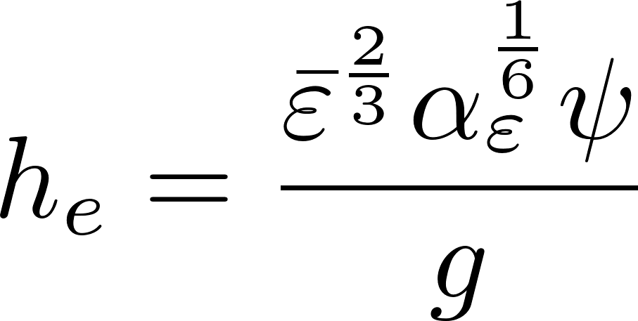
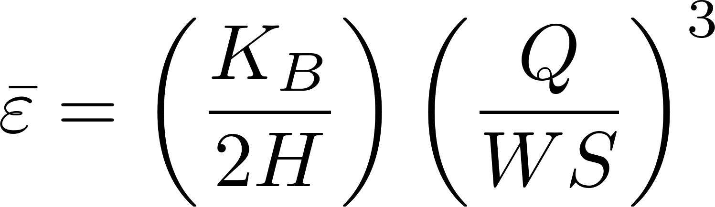
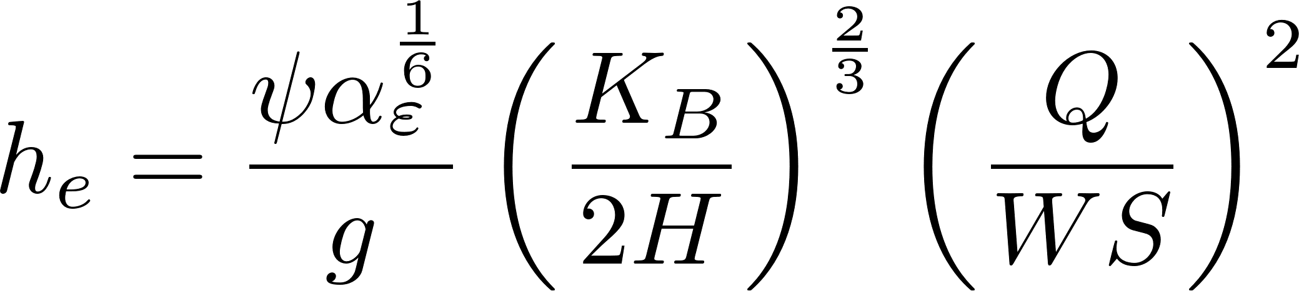
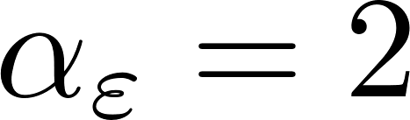
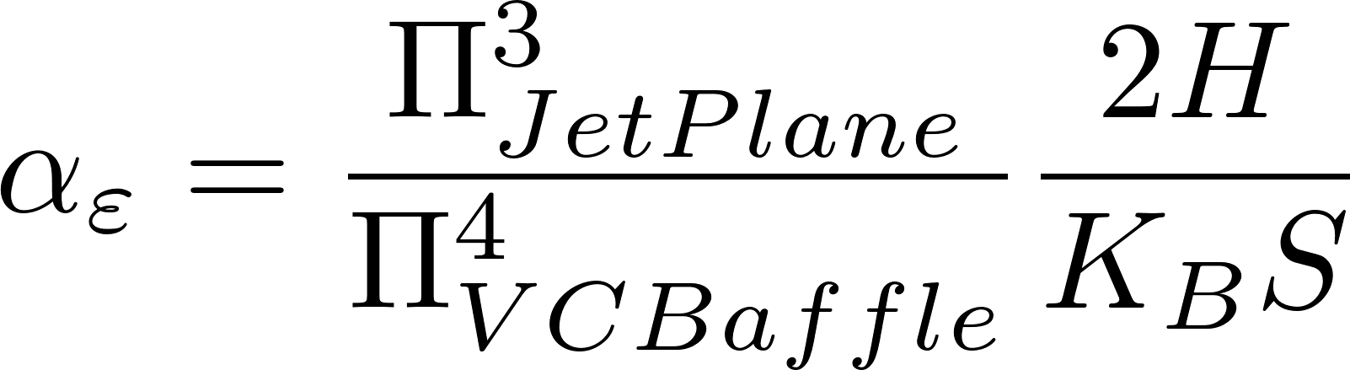
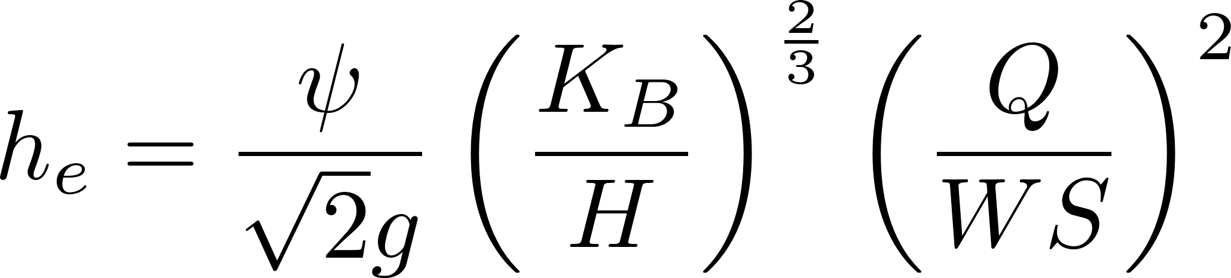
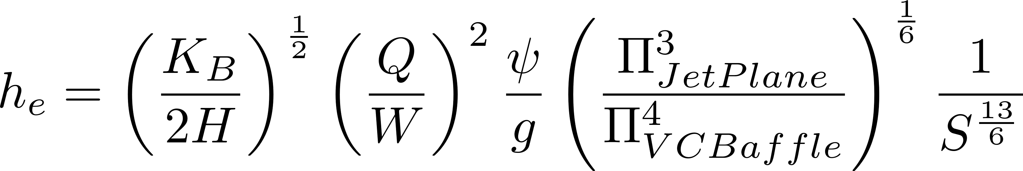
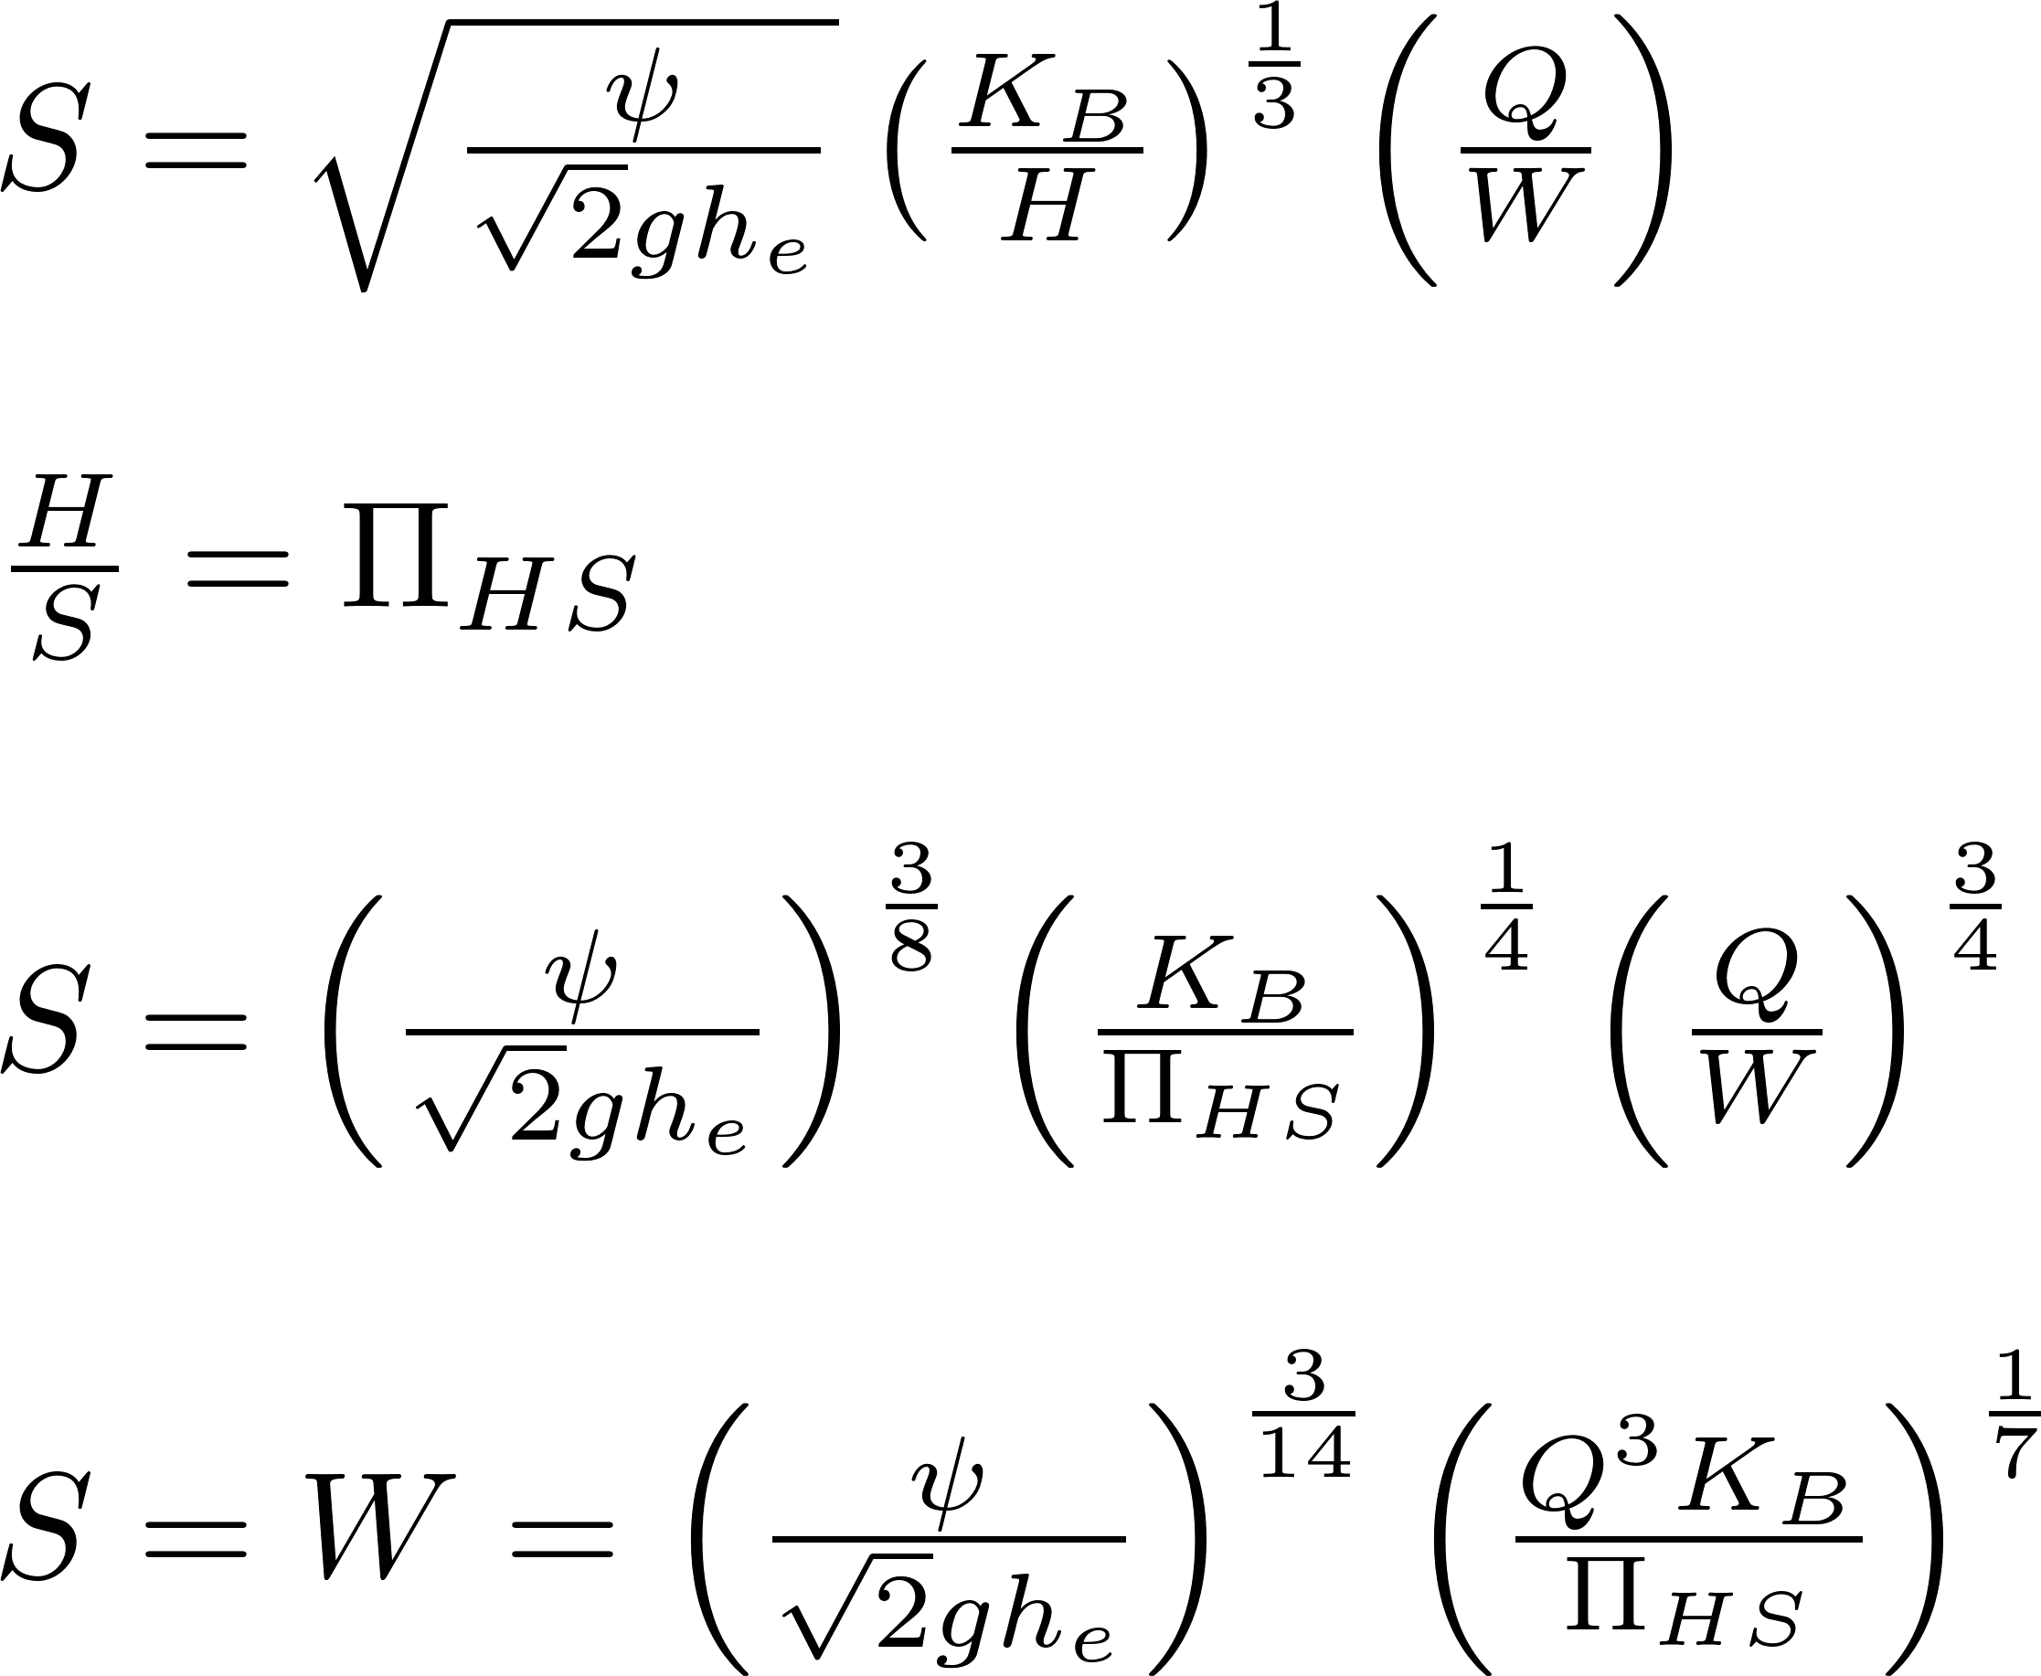
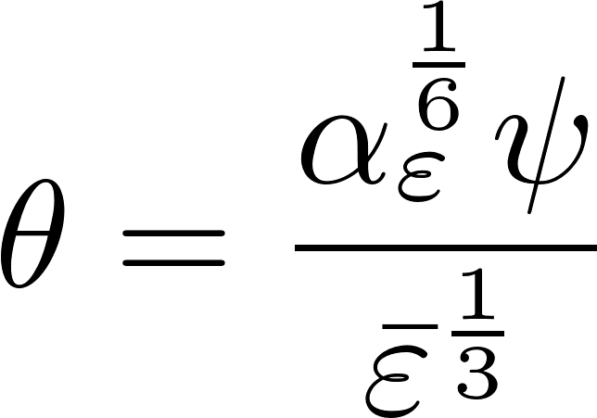
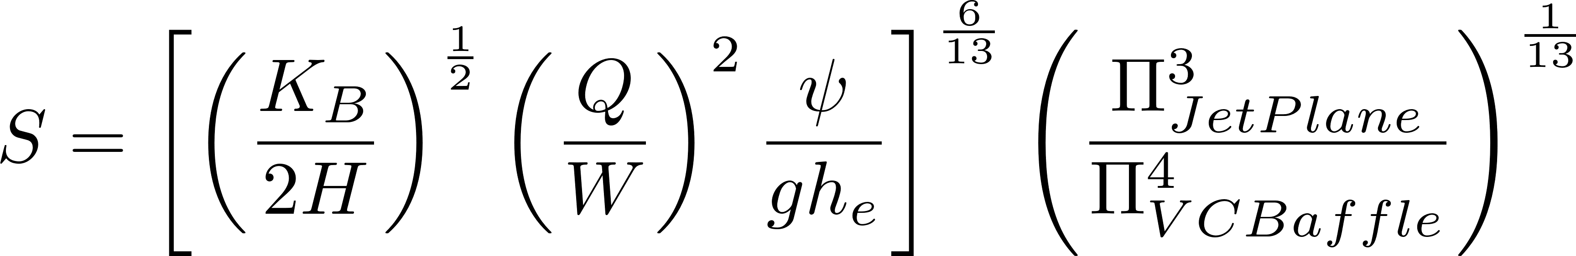
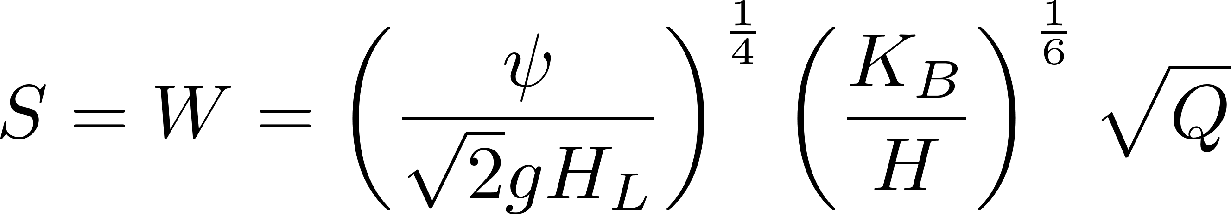
Get equation for Spacing as function of head loss

Slide 23
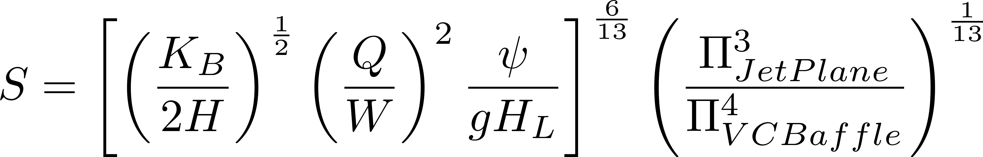
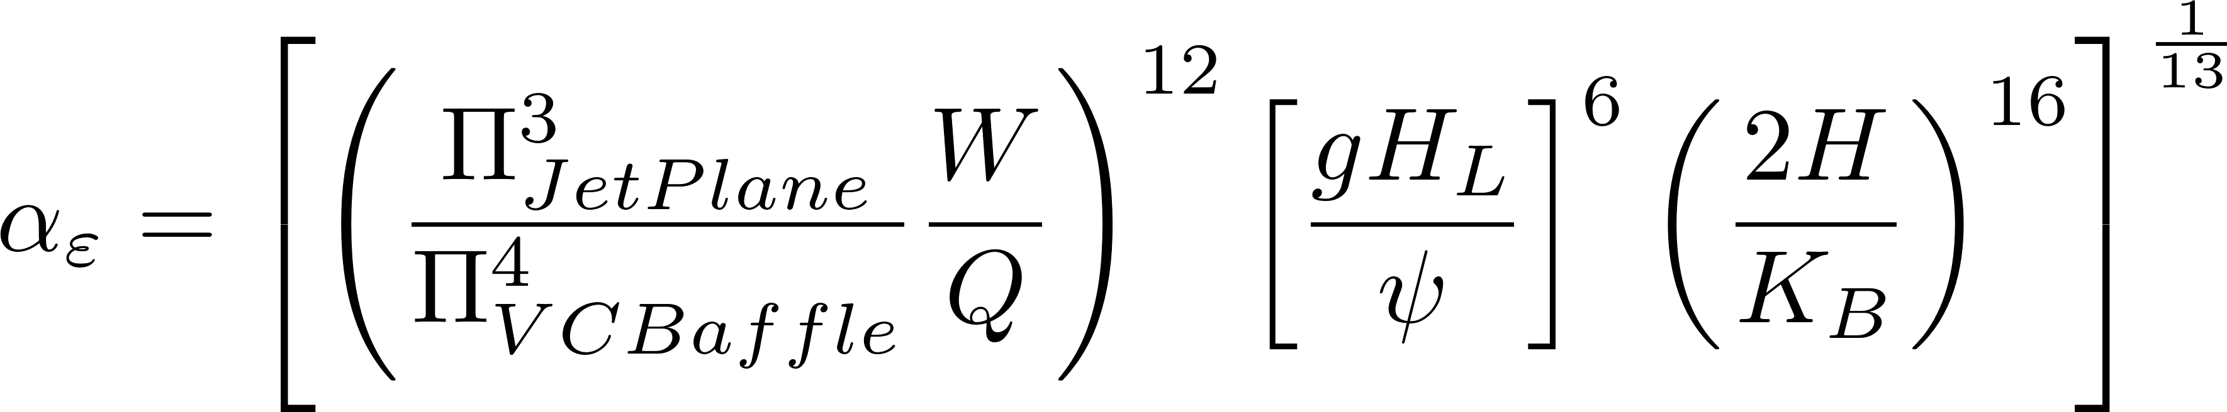
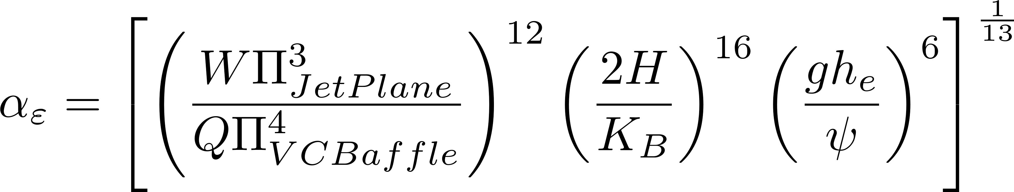
Find αε as function of head loss

Slide 24
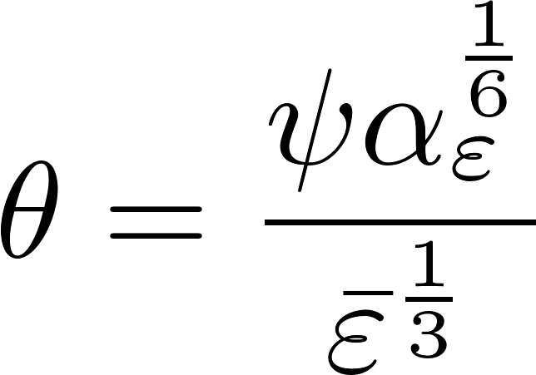
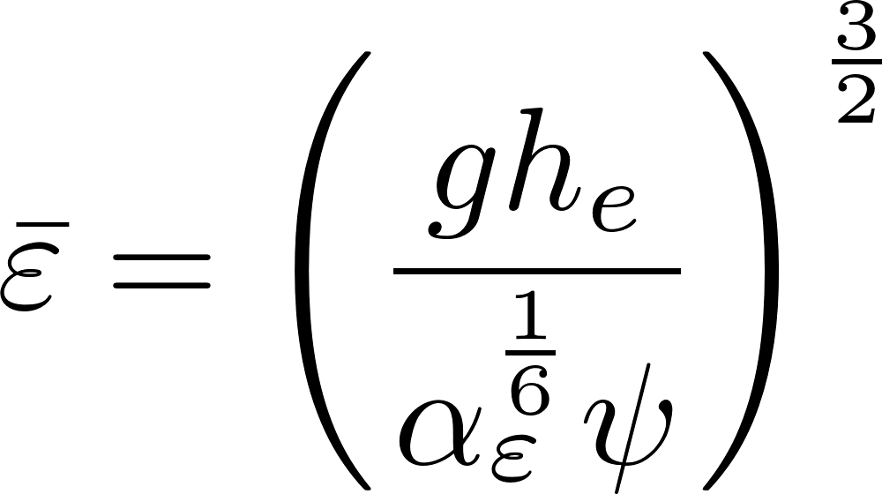





Find residence time as function of Head Loss

Slide 25



Plan View Area as a function of head loss

Slide 26




Cost of floc baffles and walls due to head loss
I assume optimal design has S=W
Floc tank walls
baffles

Slide 27



Cost as function of head loss

Slide 28
Optimal head loss for a flocculator given 70 m^2/3 collision potential
Notes:
See file Optimal Energy Dissipation rate minimum reactor volume
Of course, this is a function of our cost estimates.

Slide 29
Optimal average and maximum energy dissipation rates
This suggests increasing the maximum energy dissipation rate to about 50 mW/kg, but if we can improve H/S, then we will want to use a lower energy dissipation rate.
Notes:
This analysis was done before making the H/S ratio optimal for all designs.

Slide 30
Optimal velocity gradient
The velocity gradient based on the average energy dissipation rate is in the conventional range of 20 to 180/s

Slide 31




Head loss

Slide 32




What is the cost ratio?
Express cost as a wall or ceiling or slab area.
Then cost per plan view area can be approximated as area per plan view area. This assumes that roof, slab, plant walls, and tank walls all have the same cost per unit area.
Cost per plan view area is due to slab and roof and tank walls. Slab and roof are order 2 if expressed as area of slab and roof per area of flocculator.
Tank wall area is H.Floc/W.Floc
Cost per head loss is due to elevation of entrance tank and taller exterior walls of plant
Walls are 4*square root of plant area

Slide 33





Can I find Q where H/S is at transition?
Use optimal head loss for Small H/S

Slide 34
As flow increases
H/S>5 and narrow W.Floc
H/S=5 as W.Floc increases to

Slide 35





Starting from Max EDR
BOD of max EDR
Calculate residence time, head loss and reactor volume
Select channel width based on reactor volume, depth, length, and odd or even number of channels

Slide 36




Starting from Average EDR
BOD of max EDR
Calculate residence time, head loss and reactor volume
Select channel width based on reactor volume, depth, length, and odd or even number of channels
Set and solve for W
Need an algorithm to solve for

Slide 37

Find maximum H given minimum W

Slide 38


Find min Q that doesn’t require obstacles
Use min W and max H/S of 5 to get minimum Q below which obstacles are needed

Slide 39
Find Max Q for vertical flow flocculator
Use max W and min H/S of 3 to get maximum Q for vertical flow flocculator

